Slide 1

Dos and don't in Javascript
Javascript good parts and what to avoid
Azat Satklichov
azats@seznam.cz,
http://sahet.net/htm/java.html,
https://github.com/azatsatklichov/java-in-deep
Notes:
JSLint can be found at http://www.JSLint.com/.
JavaScript statements are composed of: Values, Operators, Expressions, Keywords, and Comments.
JavaScript programs (and JavaScript statements) are often called JavaScript code.
var x, y, z; // Statement 1 x = 5; // Statement 2 y = 6; // Statement 3
var x = 5 * 10; //Statement 4
JavaScript uses the var keyword to declare variables.
An expression is a combination of values, variables, and operators, which computes to a value. E.g. 5 * 10 or x * 10
JavaScript variables are containers for storing data values.
All JavaScript variables must be identified with unique names. JavaScript identifiers are case-sensitive.
Creating a variable in JavaScript is called "declaring" a variable.
var carName;
Difference Between Unicode and UTF-8: Unicode is a character set. UTF-8 is encoding.
Unicode is a list of characters with unique decimal numbers (code points). A = 65, B = 66, C = 67, ....
This list of decimal numbers represent the string “ahello": 97 104 101 108 108 111
Encoding is how these numbers are translated into binary numbers to be stored in a computer:
UTF-8 encoding will store "hello" like this (binary): 01101000 01100101 01101100 01101100 01101111
Encoding translates numbers into binary . Character sets translates characters to numbers.

Slide 2
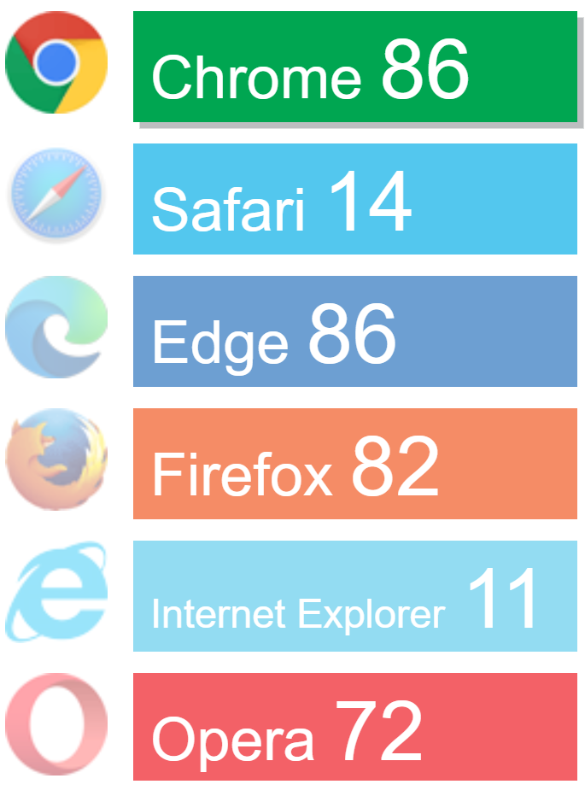
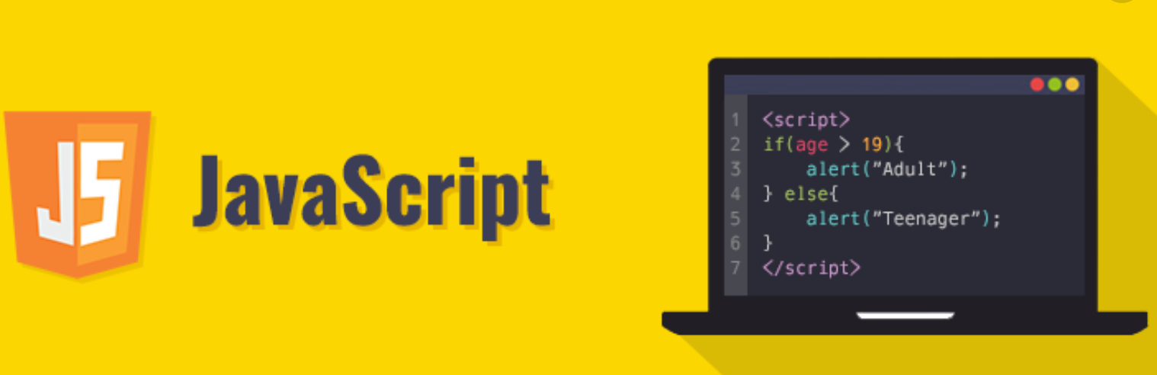
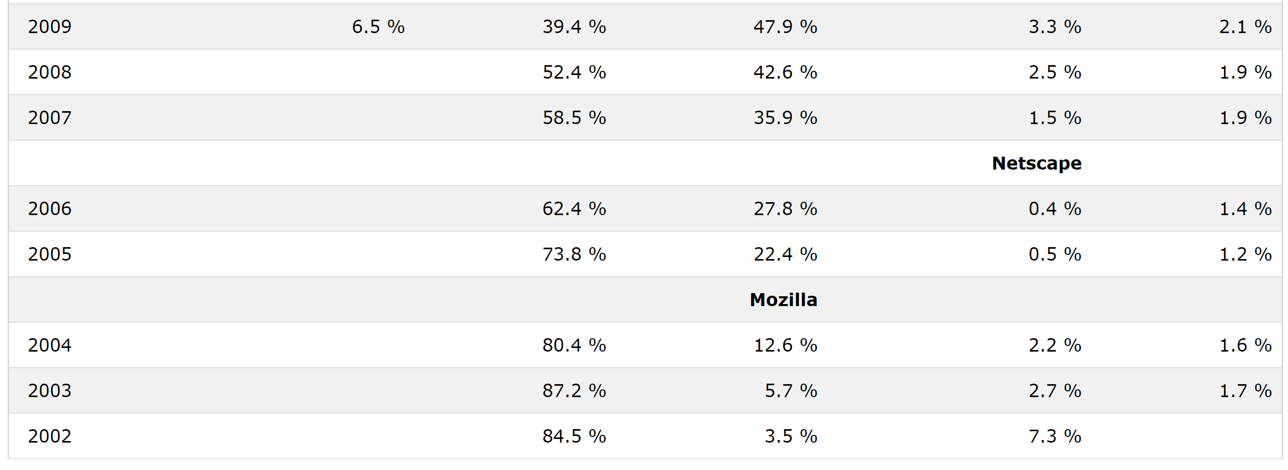
JS History, Ecosystem
Languages for Web: HTML/CSS, JavaScript, Java applets, Flash/Flex
1993 Mosaic - first browser
1994 - Netscape Navigator
1995 – Mocha -> Live Script(JS) -> JavaScript (Brendan Eich, 10 days dev.)
1996 Browser war started: Microsoft JScript for IE browser
1997 – ECMAScript (spec.): JavaScript, JScript, ActionScript
2005 – AJAX born (E4X)
2008 – ES4 (Yahoo, Google, Microsoft, ..) -> ES6
2009 – CommonJS: Browserless JS, way to Node.js.
2015-2018 versions of JavaScript (ES6 - ECMAScript 2015)
Libs/Frameworks: jQuery, MooTools, D3.js, ExtJS, Angular, Vue, React, ..
UnitTesting: Unit.js, Jasmine, Jest, Mocha, Protractor, Cypress, ..
JS Alternatives: in writing code / transpilers: DART, Typescript, AtScript, Elm, ClojureScript, Kaffeine, CoffeeScript, BottomLine, Opal, Roy, …
Alongside client and server software, it is now even possible to write native mobile apps using JavaScript. Also one language for FE&BE&DB
JS Engines:
V8 from Google
SpiderMonkey by Mozilla
JavaScriptCore from Apple
Chakra by Microsoft
Tamarin from Adobe Flash.
Rhino & Nashorn by Oracle Java
Notes:
1995 – Mocha -> Live Script(JS) -> JavaScript (Brendan Eich, 10 days dev.)
Dynamic behavior via scripting, name JS came from Netscape’s support of Java applets within its browser. Or marketing tactic to compete with Java.
Microsoft reverse-engineered Navigator interpreter to create own JScript for IE browser
, improved user-experience, XMLHttpRequest
Strict mode, JSON support, trim(), Array.isArray() and iteration methods
Security problems: XSS, CSRF,
Plugins: AdobeFlash, .. Applets,
2008 – ES4 Harmony (Yahoo, Google, Microsoft, ..) -> ES6 (2015)
CommonJS project promotes: run Browserless JS, way to Node.js.
2015-2018 versions of JavaScript (ES6 - ECMAScript 2015)
let, const, find(), findIndex(), **, pads, async, rest, ..
JavaScript is a sloppy language, but inside it there is an elegant, better language. JSLint helps you to program in that better language and to avoid most of the slop.
Added string padding Added Object.entries Added Object.values Added async functions Added shared memory
Added rest / spread properties Added asynchronous iteration Added Promise.finally() Additions to RegExp
Alongside client and server software, it is now even possible to write native mobile apps using JavaScript.
https://www.webdesignerdepot.com/2019/11/is-there-a-viable-alternative-to-javascript/
https://codeburst.io/8-javascript-alternatives-for-web-developers-to-consider-22f8d38bdfa9
Migrating from Java Applets to plugin-free Java technologies. Java Web Start, or JavaFX.
Java applets are executed in a sandbox by most web browsers, preventing them from accessing local data like the clipboard or file system.
The code for Java Web Start was not released by Oracle as part of OpenJDK
In March 2018, Oracle announced it will not include Java Web Start in Java SE 11 (18.9 LTS) and later.
https://en.wikipedia.org/wiki/Java_Web_Start
https://openwebstart.com/
Java Web Start (JWS) was deprecated in Java 9, and starting with Java 11, Oracle removed JWS from their JDK distributions.
Dart
Dart is an object-oriented C-like language created by Google as a replacement for JavaScript. It does away with JavaScript’s prototype inheritance system in favor of a more traditional object-oriented approach that will be familiar to anyone who has worked with Java or C++. Unlike JavaScript, Dart is a statically typed language, eliminating common sources of error in JavaScript code. Dart supports type inference, so it’s not necessary to include type boilerplate every time you declare a variable or a function.
Use the dart2js tool to compile Dart code to deployable JavaScript. Another Dart-to-JavaScript compiler, dartdevc, is for development use only.
Still, one of the most beneficial features of this JS alternative lies in the fact that it allows you to go beyond client-side development and create standalone applications.
Google’s UI toolkit, it’s possible to build native web, desktop, and mobile apps.
Dart is regularly upgraded by Google, but if compared to JavaScript it still has fewer capabilities and a smaller community.
TypeScript
TypeScript is Microsoft’s entry in the race to a better JavaScript. Unlike Dart, TypeScript is not an entirely new language, but a superset of JavaScript. Valid JavaScript can be compiled by the TypeScript compiler, but TypeScript adds several new features that improve on and modernize JavaScript’s limitations, the most important of which is an optional type system.
Many JavaScript frustrations are caused by its lack of static typing, limiting the checks that the compiler can do before runtime. TypeScript, as the name suggests, implements a type notation that developers can use to bring type safety to web application programming. Like Dart, TypeScript supports type inference.
It’s worth mentioning that TypeScript is more popular than its Google competitor. The Angular framework is developed with TypeScript, even though it’s a Google project. TypeScript can be used with React and Vue too.
Elm
Dart and TypeScript have a recognizable kinship to JavaScript and C. Elm is different. It is a statically typed functional language more similar to Haskell than C, but without the head-scratching complexity of Haskell.
Elm is, essentially, a domain-specific language for building web front-ends.
Elm is not a general purpose language like JavaScript and doesn’t try to be; instead, creator Evan Czaplicki is focused on building the best possible front-end web app development experience. Elm’s main advantage is that, through static types and immutable values, it eliminates many potential bugs in front-end code. Elm advertises itself as a language that has “no runtime exceptions in practice,” meaning that if an Elm program runs at all, it’s unlikely to encounter show-stopping bugs in production.
ClojureScript
Continuing our voyage away from JavaScript-like languages, we arrive at ClojureScript, a version of the Clojure programming language which can be compiled to JavaScript. Clojure is a Lisp that runs on the Java Virtual Machine. Like Elm, Clojure is a functional language with immutable data types. Unlike Elm, it is a general-purpose programming language that can be used on the back-end with the JVM and the front-end via JavaScript.
ClojureScript is an implementation of Clojure programming language with a compilation into JavaScript. It emits JS code which is compatible with the compilation mode of the Google Closure compiler. It smoothly works in most browsers, is compatible with mobile platforms and Node, js. It is a simple and powerful programming tool, though not as popular as JavaScript.
KAFFEINE
Kaffeine is actually a set of extensions to the JavaScript syntax intended to make certain tasks much easier. For example, it helps front-end devs with JavaScript’s callback functions given that it supports asynchronous operations.
With Kaffeine, the process of debugging is much simpler, and besides being easy on developers, this JS extension is also beneficial for the end-user as the browser doesn’t freeze which means that user experience is smooth.
Again, a much smaller community and the lack of resources make this programming language a bit obscure.
COFFEESCRIPT
CoffeeScript is said to improve the readability of the original language as well as simplify code and make it shorter. Its compatibility with Node.js is another advantage.
However, it’s important to mention that developers who want to use CoffeeScript still need to be prolific in JavaScript. One of its main disadvantages is a limited set of features as well as the fact that JavaScript released its ES6 version upgrade which practically rendered CoffeeScript redundant (this upgrade accelerated JavaScript and made it almost as fast as CoffeeScript).
This language is transcomplied into JS. What it does is improving readability of JavaScript and making the code simpler and shorter. CoffeeScript can also be used with Node.js. It is not a modification or a subgroup of JavaScript, though. But if you want to use it for coding, you need to know JavaScript anyway. Drawbacks of CoffeeScript include a need for compilation, a limited feature set and few specialists writing in it.
The Bottomline
In a nutshell, JavaScript is, at the moment, a one of a kind client-side programming language, and it’s here to stay.
These alternatives can enhance it, and address some of its shortcomings, but cannot really run without a JavaScript framework, so it’s safe to say that we’ll still have to wait for JavaScript’s true successor which will be able to work independently of it.
Opal
It is one of object-oriented languages acting as a transcompiler to JavaScript from Ruby. As developers claim, Opal is developed to complement or completely replace other languages including JavaScript, Java, and C, C++, C#and Eifel. However, as of today, its popularity it low. And still, it is certainly worth mentioning.
Roy
Like many other languages, Roy is compiled to JavaScript. It has been developed as an experimental tool and to a large extent resembles JavaScript. Roy not only makes generation of code simpler, but also has some features of functional languages like pattern matching, whitespace significant syntax and others. Here again, the main problem is low popularity of the language.

Slide 3
What brings Typescript (compile time check, …. )
Typed Superset of JS, transpiled to JS (no type information). ES5 | ES6 ,
Static type, Composing types, Generic, REST args,
OOP features: Interfaces, Classes, Enums, ..
More …
Do's and Don'ts: https://www.typescriptlang.org/docs/handbook/declaration-files/do-s-and-don-ts.html
Don’t ever use the types Number, String, Boolean, Symbol, or Object
/* WRONG */ /* OK */
function reverse(s: String): String; function reverse(s: string): string;
Return Types of Callbacks: Don’t use the return type any for callbacks whose value will be ignored:
/* WRONG */ /* OK */ (even VOID is problematic: not type, discards value, .. )
function fn(x: () => any) { x(); } function fn(x: () => void) { x(); }
It still does not solve the problems caused by JS, …
JavaScript is a sloppy language, and does a lot error-forgiveness. JSLint/ESLint/TSLint or TS or libraries like (lodash, decimal.js, .. ) helps you to program better JS code and to avoid most of the slop.
Notes:
JSLint can be found at http://www.JSLint.com/.

Slide 4
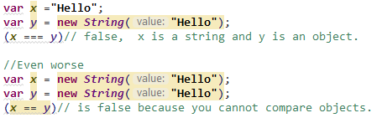
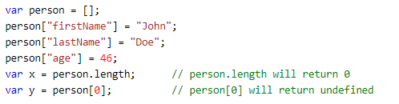
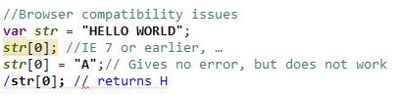
Best Practices
Avoid Global Variables: Global variables and functions can be overwritten by other scripts
Beware of Automatic Type Conversions: “3”+”2”=32, “3”-”1”=2 Confusing Addition & Concatenation
Use Parameter Defaults: otherwise undefined if not provided
Avoid using eval() : run text as code, security issue, like bat or shell files
Misunderstanding Floats: var y = 0.2; var z = x + y // result in z will not be 0.3;
Avoid creating objects via new on Number, String, Boolean, Objects, Array, ..
Accessing Arrays with Named Indexes:
properties will produce undefined or incorrect results:
Undefined is Not Null
Be ready to expect weird results
Reduce Activity in Loops
Reduce DOM Size
Avoid Using with
Reduce DOM Access: Accessing the HTML DOM is slow
ES5/6, TS, JSLint/EsLint, new libraries like lodash ,..
console.log("3" + "2");//32 console.log("3" - "2");//1
The Problematic/Sloppy part of JavaScript - reason to avoid
- It’s weakly typed, which makes the code comparatively obscure;
Code is open, can be used for malicious purposes and compromise the client-side security;
Code has to be tested on different browsers, won’t execute/interpret in the same way on every browser;
- Drawbacks including IEEE 754 Double Precision, the fact that a number of functions and properties tend to be executed differently across browsers, aggressive coercion, and problematic global variables (to name just a few).

Slide 5
JavaScript Data, Object types:
Primitive Data Types: string, number, boolean, symbols(es6), null, undefined. Primitive values are immutable
Types of Objects: [type object] Object, Date, Array, String, Number, Symbol, Boolean, function[function]. Mutatble key-col.
Types contain no values: null, undefined [typeof null is object], [typeof undefined is undefined]
HOISTING
JavaScript Declarations are Hoisted. Variables can be used before declared. It is JS's default behavior of moving all declarations regardless of where a function is placed, to the top of the scope. JavaScript only hoists declarations, not initializations.
//eg. const and let
carName = "Volvo"; document.getElementById("demo").innerHTML = carName; let carName; //ReferenceError: Cannot access 'carName' before initialization
x = 5;// Assign 5 to x ///some logic var x; | <script> var x = 5; // Initialize x elem = document.getElementById("demo"); // Find an element elem.innerHTML = "x is " + x + " and y is " + y; // Display x and y var y = 7; // Initialize y </script>
The function Statement, function Expression - fun-statements (not fun-expression) are subject to hoisting.
function foo( ) {} | var foo = function foo( ) {};
Notes:
Variables defined with block-scoped let and const are hoisted to the top of the block, but not initialized.
Meaning: The block of code is aware of the variable, but it cannot be used until it has been declared.
// let, const are hoisted but not initialized, code is aware of variable & can not be used until declared
In JavaScript, arrays are objects, functions are objects, regular expressions are objects, and, of course, objects are objects.
Objects in JavaScript are class-free.
When adding
JavaScript objects are containers for named values called properties or methods (method is a function stored as a property)
Accessing Object Properties: objectName.propertyName, objectName["propertyName"]
a number and a string, JavaScript will treat the number as a string.

Slide 6

Objects JS objects inherit members from the prototype chain so they are never truly empty. To test for membership without prototype chain involvement, use the hasOwnProperty method or limit your results
new - creates a new object that inherits from the operand’s prototype member, and then calls the operand, binding the new object to this. Avoid creating Strings, Numbers, Booleans, Objects, & Arrays as Objects! Unexpected results and slow down execution speed. Two objects can’t be even compared. There is no compile-time or runtime warning.
var a = new String(‘b’); //String object var b = new Number(10); //Number object var c = new Boolean(true); //Boolean object
var d = new Object(); //Object object
var e = new Array(); //Array object
let check = new Boolean (false); if(check) { console.log("WOW FOUND, even FALSE");//FOUND, even FALSE } let check2 = false; if(check2) { console.log("WOW FOUND, even FALSE");//skipped }
Use:var a = “b"; var b = 10; var c = true; var d= {}; var e =[] instead
this - keyword refers to the object it belongs to. It has different values depending on where it is used:
In a method, this refers to the owner object.
Alone, this refers to the global object, [object Window].
Also, in "use strict“ this refers to the global object [object Window].
In a function, this refers to the global object. [object Window].
In a function, in strict mode, this is undefined.
In an event, this refers to the element that received the event.
Methods like call(), and apply() can refer this to any object.
In short, with arrow functions there are no binding of this.
Notes:
JavaScript’s new operator creates a new object that inherits from the operand’s prototype member, and then calls the operand, binding the new object to this. This gives
the operand (which had better be a constructor function) a chance to customize the new object before it is returned to the requestor.
If youforget to use the new operator, you instead get an ordinary function call, and this is bound to the global object instead of to a new object. That means that your
function will be clobbering global variables when it attempts to initialize the new members. That is a very bad thing. There is no compile-time warning. There is no
runtime warning.
By convention, functions that are intended to be used with new should be given names with initial capital letters, and names with initial capital letters should be used
only with constructor functions that take the new prefix. This convention gives us a visual cue that can help spot expensive mistakes that the language itself is keen to
overlook. An even better coping strategy is to not use new at all.
In JavaScript, almost "everything" is an object.
Booleans can be objects (if defined with the new keyword)
Numbers can be objects (if defined with the new keyword)
Strings can be objects (if defined with the new keyword)
Dates are always objects
Maths are always objects
Regular expressions are always objects
Arrays are always objects
Functions are always objects
Objects are always objects
JavaScript objects inherit members from the prototype chain so they are never truly empty.
To test for membership without prototype chain involvement, use the hasOwnProperty method or limit your results
When adding a number and a string, JavaScript will treat the number as a string.
Six other escape sequences are valid in JavaScript:
Code Result
----------------------------
\b Backspace
\f Form Feed
\n New Line
\r Carriage Return
\t Horizontal Tabulator
\v Vertical Tabulator
The 6 escape characters above were originally designed to control typewriters, teletypes, and fax machines. They do not make any sense in HTML.
A Function is much the same as a Procedure or a Subroutine, in other programming languages.
The function Statement Versus the function Expression
function statements are subject to hoisting. This means that regardless of where a
function is placed, it is moved to the top of the scope in which it is defined.
Immediately-invoked Function Expression
A Function is much the same as a Procedure or a Subroutine, in other programming languages.
The function Statement Versus the function Expression
function statements are subject to hoisting. This means that regardless of where a
function is placed, it is moved to the top of the scope in which it is defined.
Immediately-invoked Function Expression

Slide 7
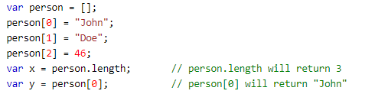
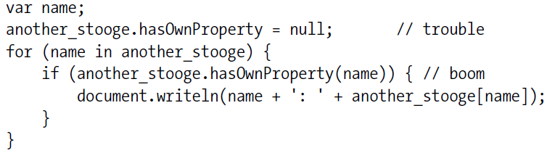
Phony Arrays - slower than real arrays
JavaScript does not have real arrays. No need to give them a dimension, and they never generate outof-bounds errors.
But their performance can be considerably worse than real arrays.
The typeof operator does not distinguish between arrays and objects.
var fruits = ["Banana", "Orange", "Apple", "Mango"]; typeof fruits; //object, how can I recognize ARRAY
1) isArray function or
2)
Another example
hasOwnProperty When using a for in loop, usually a good idea to use hasOwnProperty(variable) to make sure the property belongs to the object you want and is not instead an inherited property from the prototype chain:
if (my_value && typeof my_value === 'object'
&& typeof my_value.length === 'number'
&& !(my_value.propertyIsEnumerable('length'))) { //my_value is definitely an array!
}
re-define arrays with named-indexes
var elms = new Array(40,100);//Creates an array with two elements (40 and 100) var elms = new Array(40);// Creates an array with 40 undefined elements!!!!!
hasOwnProperty - can be replaced with other function
for (myvariable in object) { if (object.hasOwnProperty(myvariable)) { ... //statements to be executed } }
Notes:
In JavaScript, arrays always use numbered indexes.
for in Statement The for in statement allows for looping through the names of all of the properties of an object.
Unfortunately, it also loops through all of the members that were inherited
through the prototype chain. This has the bad side effect of serving up method functions when the interest is in the data members.
When using a for in loop, usually a good idea to use hasOwnProperty(variable) to make sure the property belongs to the object you want a
nd is not instead an inherited property from the prototype chain:

Slide 8
Semicolon insertion When inserting semicolons in places where they are not welcome, returns undefined ;)
return { status: true }; //returns undefined | return { status: true }; //returns { status: true }
null and undefined
null and undefined differences
Undefined refers to something which has not yet been assigned a value (yet).
Null refers to something which definitively has no value. In that case, just return a null. Also different browsers seem to be returning these differently.
typeof undefined //undefined typeof null // object null == undefined // true null === undefined // false
void - In JavaScript, void is an operator (but in many languages, void is a return type) that takes an operand and returns undefined. This is not useful, and it is very confusing. Avoid void.
console.log(void 0); //undefined console.log(undefined); //undefined
// a naughty global variable from another script var undefined = "oops";
ES5 improved this by making undefined immutable
void - introduced to handle the shadowing of undefined in pre-ES5, where undefined on the global scope can be overridden or shadowed. Is an operator not return type.
1) let i = void 2; // i === undefined
3) void function what() { console.log('What') }(); //using void for IIFE will always evaluate to undefined.
what();
2) <a href="javascript:void(0)">Click Here</a>
4) let tt = (function() {})() === void 0; //undefined console.log(tt); //true
VOID method returns UNDEFINED. //In Java VOID method does not return anything, …
Notes:
void is introduced to handle the shadowing of undefined in the pre-ES5 where undefined on the global scope can be overridden or shadowed.
using void for IIFE will always evaluate to undefined.
When adding a number and a string, JavaScript will treat the number as a string.
typeof undefined // undefined typeof null // object null === undefined // false null == undefined // true

Slide 9
Global Variables should be avoided
Visible in every scope, can significantly complicate the behavior of the program, harder to run subprograms
Can be re-declared, re-assigned, …
Three ways to define global variables
var foo = value; (any place outside the function)
window.foo = value; (add directly to global object)
foo = value; (implied global or implicit global via variable hoisting) more open to buggy programs
JS has function SCOPE: Each function creates new scope. Variables declared in function, become LOCAL to the function.
Undefined Variables and Functions. If a variable is not explicitly declared, then JS assumes that the variable was global
Alternative:
To minimize use of global-var: var myApp = {}; which holds all fileds for your app. e.g. Angular style…
Use let|const (scoped var) .
Use jslint/eslint: helps to catch variable-hoisting bugs, to find if you use variable out of scope
Or closure for data hiding
E.g.1 function foo() { var variable1, variable2; variable1 = 5; varaible2 = 6; return variable1 + varaible2; } | E.g.2 var carName = "Ford"; console.log(carName); var carName; //still has value Ford console.log(carName); var carName = 76; //type changed console.log(carName);
Notes:
Use let|const (scoped var) . Tell about JS function SCOPE , now block SCOPE possible
Use eslint: helps to catch variable-hoisting bugs, to find if you use variable out of scope
e.g. /*eslint no-redeclare: "error"*/ , /*eslint no-use-before-define: "error"*/
Or closure for data hiding
Visible in every scope, can significantly complicate the behavior of the program, harder to run subprograms
Can be re-declared, re-assigned, …
Three ways to define global variables
var foo = value; (any place outside the function)
window.foo = value; (add directly to global object)
foo = value; (implied global or implicit global via variable hoisting) more open to buggy programs
JS has function SCOPE: Each function creates new scope. Variables declared in function, become LOCAL to the function.
Undefined Variables and Functions. If a variable is not explicitly declared, then JS assumes that the variable was global
JSLint defines a professional subset of JavaScript, a stricter language than that defined by the third edition of the ECMAScript Language Specification. The subset is
closely related to the style recommendations from Chapter 9.
When adding
JavaScript objects are containers for named values called properties or methods (method is a function stored as a property)
Accessing Object Properties: objectName.propertyName, objectName["propertyName"]
a number and a string, JavaScript will treat the number as a string.
function foo() { var variable1, variable2; variable1 = 5; varaible2 = 6; return variable1 + variable2; }
/*eslint no-use-before-define: "error"*/
JavaScript depends on global variables for linkage. All of the top-level variables
of all compilation units are tossed together in a common namespace called the global
object. This is a bad thing because global variables are evil, and in JavaScript they are
fundamental. Fortunately, as we will see, JavaScript also gives us the tools to mitigate
this problem
JavaScript uses the block syntax, but does not provide
block scope: a variable declared in a block is visible everywhere in the function
containing the block. This can be surprising to programmers with experience in
other languages.

Slide 10
Typeof, instanceof - returns a string that identifies the type
console.log( typeof 0 ); // "number" console.log( typeof new Number() ); // "object" console.log( typeof Infinity ); //"number" console.log( typeof NaN ); // "number" console.log( typeof 'Hi' ); // "string" console.log( typeof new String("Hi") ); // "Object" console.log( typeof true ); // "boolean" console.log( typeof new Boolean(true) ); //"object" console.log( typeof null ); // "object“, not null
console.log( typeof undefined ); //"undefined" //console.log( typeof new Symbol() ); // "symbol" - only in ES6 console.log( typeof [] ); //"object“ - arrays are objects.
console.log( typeof [1,2,3]); // "object", not "array" console.log( typeof new Array(1,2,3)); // "object"
console.log( typeof new Date() ); //"object" console.log( typeof /^$/ ); // "object“
console.log( typeof new RegExp('^$')); //"object"
console.log( typeof {a: "abc"} ); //"object" console.log( typeof typeof {} ); //"string" console.log(typeof function () {}); //function
All objects are truthy and null is falsy
Arrays are objects in JavaScript so typeof array will return 'object'
You cannot use typeof to determine if a JS object is an array (or a date).
var myArr = [1,2,3,4]; console.log(myArr.constructor.toString().indexOf("Array") > -1); console.log(myArr.constructor === Array );//2-way
isArray //3 way, …
Notes:
When adding a number and a string, JavaScript will treat the number as a string.
When testing for a missing member of an object for example, you need to use undefined and not null.
undefined and NaN are actually global variables instead of constants but don't change their values.

Slide 11
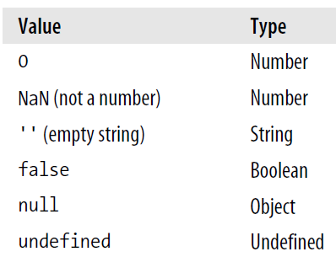

Falsy Values - These values are all falsy, but they are not interchangeable.
All other values are truthy including all objects & the string 'false‘.
if (my_value && typeof my_value === 'object') { //then my value is definitely an object or an array
//and truthy (first statement) }
let check = new Boolean (false); if(check) { console.log("WOW FOUND, even FALSE");//FOUND, even FALSE } let check2 = false; if(check2) { console.log("WOW FOUND, even FALSE");//skipped }
All objects are truthy and null is falsy
Instanceof checks if an object is an instance of a class or constructor
//array is complex type, even though [] has typeof Object console.log([] instanceof Array); // true console.log(typeof []); //object
E.g. shows clarity on the differences between typeof and instanceof
//instance of only works for complex data type
const a = "I'm a string primitive"; const b = new String("I'm a String Object"); console.log(a instanceof String); //returns false console.log(b instanceof String); //returns true
Notes:
When adding a number and a string, JavaScript will treat the number as a string.
When testing for a missing member of an object for example, you need to use undefined and not null.
undefined and NaN are actually global variables instead of constants but don't change their values.

Slide 12
1. == (equal values) 2. === (both type and value, but still not complete) 3. Object.is()
Comparing two JavaScript objects will always return false.
//result is same with number/Number, boolean/Boolean, array/Array
var x = “JavaScript";
var y = new String("JavaScript");
x == y //true, equal values
x === y //false, have different types (string and object)
Even worse: Objects cannot be compared:
var x = new String("JavaScript"); var y = new String("JavaScript");
// (x == y) is false because x and y are different objects
// (x === y) is false because x and y are different objects
// just if two obj same, NaN can be used during comparison
Object.is(x, x)); //true Object.is(x, y)); //false
Manual comparison needed to compare Objects:
Read properties and compare them manually. Eg. object1.name === object2.name
You also can use Object.keys() [shallow(for primitives) or deep versions] just to fasten the process.
Other ways: ES6 way Object.entries(k1).toString() === Object.entries(k2).toString(); No for nested obj+keys order
2) JSON.stringify (key order matters) 3) LODASH
In JAVA .. Just equals() checks value equality, == if both references to same OBJ in memory
== operator always converts (to matching types) before comparison.
=== operator forces comparison of values and type:
5==‘5’ //true
5===“5” //false
0 == ""; // true 1 == "1"; // true 1 == true; // true 0 === ""; // false 1 === "1"; // false 1 === true; // false

Slide 13
parseInt – no warning or informative message when converting also issue is with dates/times/
Eg1: parseInt(“32") and parseInt(“32 meters") produce the same result 32,
Eg2: parseInt(“08") and parseInt(“09") based on Base 8, but es5 (integer) ;) Provide Radix.
Floating point (64bit), no warning|info message, behaves differently in different browser converts a string into an integer.
0.1 + 0.2 is not equal to 0.3 //0.30000000000000004 ==> var z = (x * 10 + y * 10) / 10; //0.3
Numbers in JS no types of numbers, like integers, short.. numbers without a period or exp. are accurate up to 15 digits
var x = 999999999999999; // x will be 999999999999999 var y = 9999999999999999; // y will be 10000000000000000
console.log(0.1 + 0.2); //0.30000000000000004 console.log(0.1 + 0.2 === 0.3); //false // ??? x = 1.0000000000000001 console.log(x === 1); //true // ???
Bitwise – JavaScript has the same set of bitwise operators (&, |, ^, ~, >>, ..) as Java: In Java they work with integers. JS has no integers. Bit operator work on 32bit, result converted back to JS, …
In JavaScript, they are very far from the hardware and very slow. JavaScript is rarely used for doing bit manipulation. As a result, in JavaScript programs, it is more likely that & is a mistyped && operator.
NaN – NaN (Not-a-Number) is not equal to any value (including itself, NaN !=== NaN) and is essentially an illegal number value, but typeOf(NaN)===number //true. Use isNaN(number) to check for NaNs
var isNumber = function isNumber(value) { return typeof value === 'number' && isFinite(value); //not NaN & Infinity
Notes:
Java: System.out.println((float) (0.1+0.2));//0.3
Use isNaN(number) to check for NaNs
NaN (Not-a-Number) is not equal to any value (including itself) and is essentially an illegal number value, but typeOf(NaN)===number is true
It only has double precision floating-point numbers. So, the bitwise operators convert their number operands into integers, do their business, and then convert them back.
In most languages, these operators are very close to the hardware and very fast. In JavaScript, they are very far from the hardware and very slow. JavaScript is rarely
used for doing bit manipulation.
Switch Fall Through
Someone wrote to me once suggesting that JSLint should give a warning when a case falls through into another case.
A common error in switch statements is to
forget to place a break statement after resulting in unintended fall-through.
When adding a number and a string, JavaScript will treat the number as a string.
When adding
JavaScript objects are containers for named values called properties or methods (method is a function stored as a property)
Accessing Object Properties: objectName.propertyName, objectName["propertyName"]
a number and a string, JavaScript will treat the number as a string.
function foo() { var variable1, variable2; variable1 = 5; varaible2 = 6; return variable1 + variable2; }
/*eslint no-use-before-define: "error"*/
JavaScript depends on global variables for linkage. All of the top-level variables
of all compilation units are tossed together in a common namespace called the global
object. This is a bad thing because global variables are evil, and in JavaScript they are
fundamental. Fortunately, as we will see, JavaScript also gives us the tools to mitigate
this problem
JavaScript uses the block syntax, but does not provide
block scope: a variable declared in a block is visible everywhere in the function
containing the block. This can be surprising to programmers with experience in
other languages.
JavaScript’s characters are 16 bits. That is enough to cover the original 65,536
(which is now known as the Basic Multilingual Plane).
Plane is a range of 65,536 (or 10000₁₆) contiguous Unicode code points from U+n0000 up to U+nFFFF, where n can take values from 0₁₆ to 10₁₆
Planes split Unicode code points into 17 equal groups:
Plane 0 contains code points from U+0000 to U+FFFF, (Basic Multilingual Plane)
Plane 1 contains code points from U+10000 to U+1FFFF (Supplementary Multilingual Plane )
…
Plane 16 contains code points from U+100000 to U+10FFFF.
Plane 0 is a special one, named Basic Multilingual Plane or shortly BMP. It contains characters from most of the modern languages (Basic Latin, Cyrillic, Greek, etc) and a big number of symbols.
Astral planes
The 16 planes beyond the BMP (Plane 1, Plane 2, …, Plane 16) are named astral planes or supplementary planes
The code points that are part of the astral planes are named astral code points. These code points are in the range from U+10000 to U+10FFFF.
An astral code point can have 5 or 6 digits in hexadecimal: U+ddddd or U+dddddd.
Let’s see some characters from astral planes:
𝄞 is U+1D11E named MUSICAL SYMBOL G CLEF
𝐁 is U+1D401 named MATHEMATICAL BOLD CAPITAL B
🀵 is U+1F035 named DOMINO TITLE HORIZONTAL-00-04
😀 is U+1F600 named GRINNING FACE
return
{
status: true
};

Slide 14

THANK YOU
References
https://www.w3schools.com/js/js_intro.asp
https://github.com/dwyl/Javascript-the-Good-Parts-notes
https://developer.mozilla.org/en-US/docs/Web/JavaScript/Reference/Global_Objects
https://medium.com/javascript-non-grata/the-top-10-things-wrong-with-javascript-58f440d6b3d8

